Slide 1
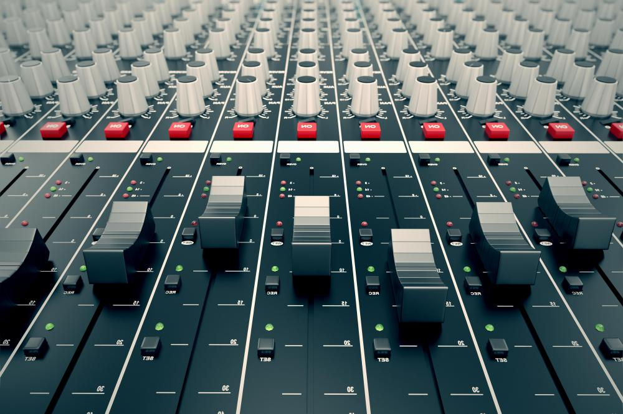

Team II Project
Audio Feature Analysis
November 2nd, 2022
Andrew Chavez Sandy Cisneros
Ben Johnson
Steven Vitulli
Ariana Wilson

Slide 2




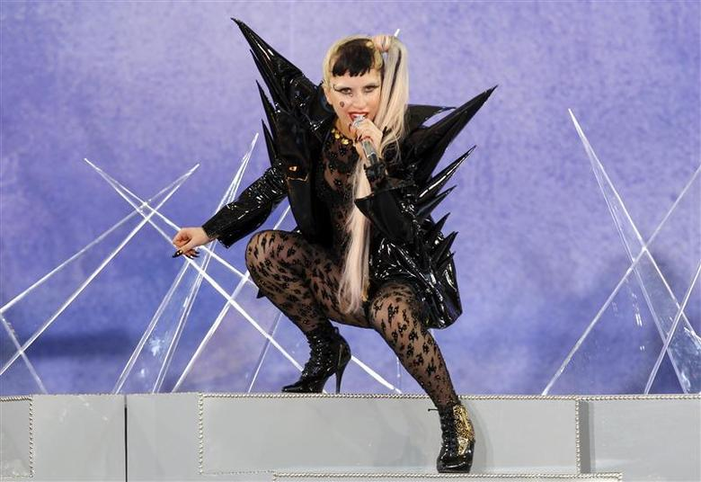
Synopsis
Why we chose this topic?
Music is an important part of our culture
No matter the different tastes in genre, it’s something that most people enjoy universally
Our team sought out to determine if:
1. Do popular ‘Top 40’ songs have any commonality and/or trends in audio features?
2. Are we able to distinguish between different genres by their audio features alone?

Slide 3




Technologies Utilized
Python (in Jupyter Notebook)
Libraries included: boto3, IPython, json, logging, os, pandas, plotly, request, spotipy, StringIO, Scikit-Learn, time, BeautifulSoup, and timeit.
AWS S3
Storage Service is a service offered by Amazon Web Services that provides object storage through a web service interface
AWS RDS
A web service running "in the cloud" designed to simplify the setup, operation, and scaling of a relational database for use in applications
Tableau
An interactive data visualization software focused on business intelligence.

Slide 4
Software Flowchart
Data Scrape
Plotly Visualization
Top40-Charts.com
AWS S3
AWS RDS
API Calls
ML
Spotify
Data Clean
Postgres
Tableau Visualization

Slide 5


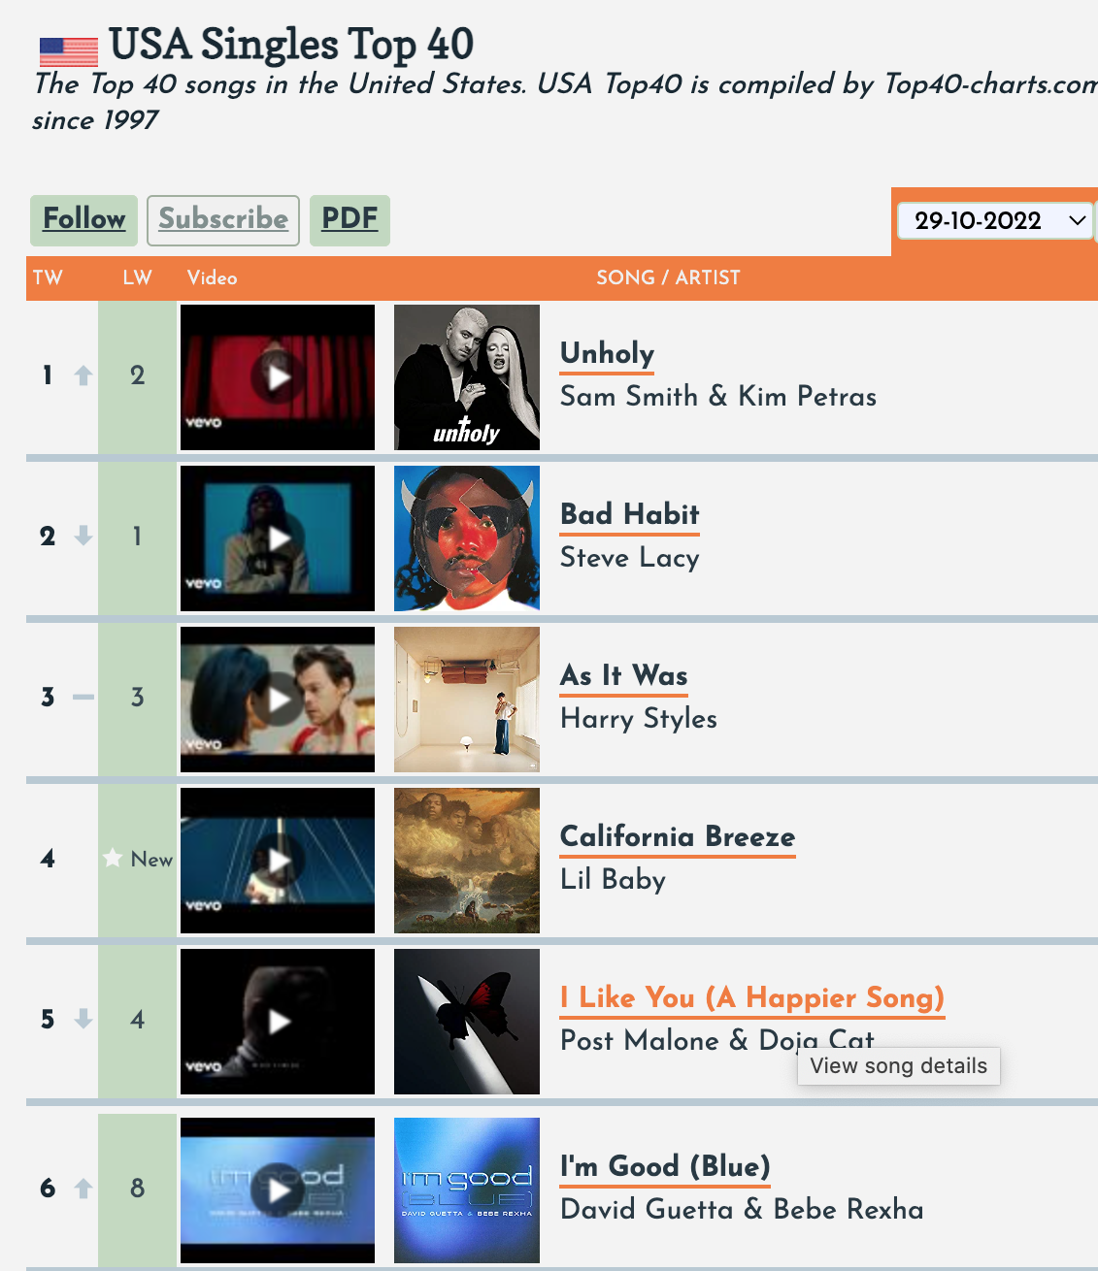
Extracting the Data
Web Scraping
Spotify Web API
13 audio features
437 genres
a_cappella
acoustic_pop
adult_standards
afrofuturism
alabama_rap
alberta_country
album_rock
alt_z
alternative_dance
alternative_hip_hop
alternative_metal
alternative_pop
alternative_rnb
alternative_rock
american_folk_revival
anarcho_punk
anti_folk
arkansas_country
arkansas_hip_hop
art_pop
art_rock
asian_american_hip_hop
atl_hip_hop
atl_trap
atlanta_bass
austin_singer_songwriter
australian_country
australian_dance
australian_electropop
australian_hip_hop
bass_house
bass_trap
bassline
baton_rouge_rap
battle_rap
bedroom_pop
bedroom_soul
belgian_dance
belgian_pop
bhangra
big_beat
big_room
black_americana
blues_rock
bossbeat
boston_hip_hop
boston_punk
boston_rock
bounce
bow_pop
boy_band
brill_building_pop
british_invasion
british_soul
britpop
bronx_hip_hop
brooklyn_drill
brostep
bubblegum_dance
cali_rap
canadian_old_school_hip_hop
canadian_pop
canadian_pop_punk
canadian_punk
canadian_rock
canadian_singer_songwriter
canadian_trap
candy_pop
cartoon
ccm
celtic
celtic_rock
chamber_pop
chicago_bop
chicago_drill
chicago_indie
chicago_rap
chicano_rap
children's_music
chopped_and_screwed
christian_alternative_rock
christian_indie
christian_music
christian_rock
chutney
classic_bhangra
classic_dubstep
classic_girl_group
classic_rock
clean_comedy
acousticness
danceability
duration
energy
instrumentalness
key
liveness
loudness
mode
speechiness
tempo
time_signature
valence

Slide 6
Extracting the Data
Web Scraping
Spotify Web API
July 7, 1997 – Oct 15, 2022
2,267 unique songs
31,275 chart entries

Slide 7

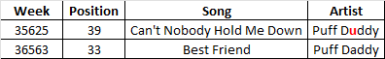
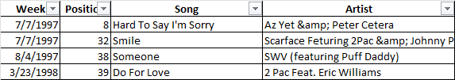
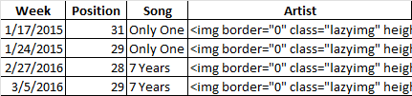
Transforming the Data
As in most cases, once the data was extracted from the Spotify API and scraped from top40charts.com we had to clean it up in order to make it usable for our purposes.

Slide 8

Loading the Data Pipeline
Created S3 storage for the results of web scrape, API Calls, and final data.
AWS CLI with Keys
Distributed Keys to Team
Access with Keys and Set Permissions
Pipeline from Jupyter Notebook to S3
Learned AWS Architecture
Originally used Pyspark Example from Colab but Converted to Python
Wrote List / Read / Write Script
No Direct Access to S3 GUI Required
Moved DataFrames Back and Forth to S3
Wrote DataFrames into S3 as CSVs
Read CSVs from S3 into Jupyter as DataFrames
List Would Allow to See All CSVs in S3 Directory
Integrated into the Rest of Script
Utilized Libraries not Taught in Class
Customizable Naming
AWS S3 to AWS RDS Postgres
Utilized AWS GLUE to Create Pipeline from S3 to RDS but Could Not Make RDS Public
Abandoned Idea as Not Convenient

Slide 9
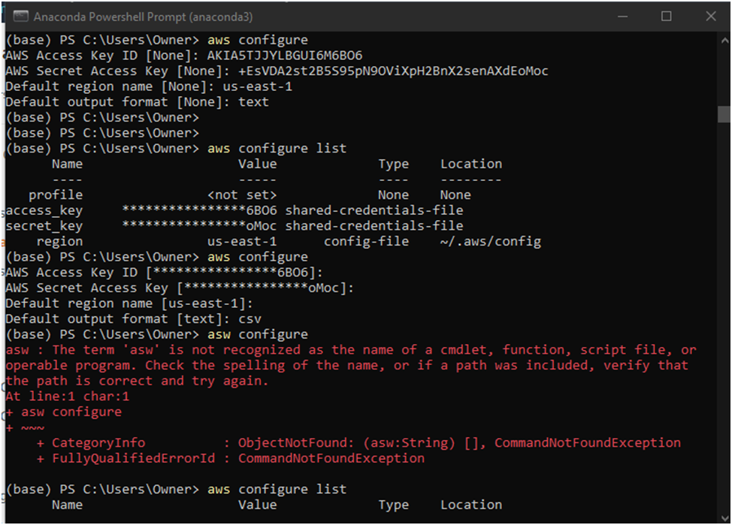
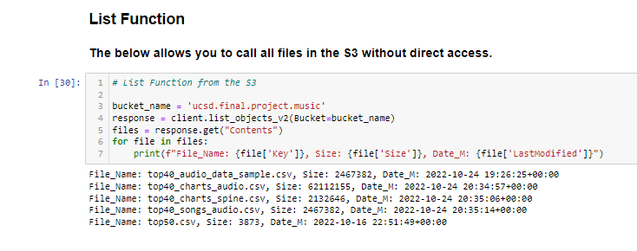
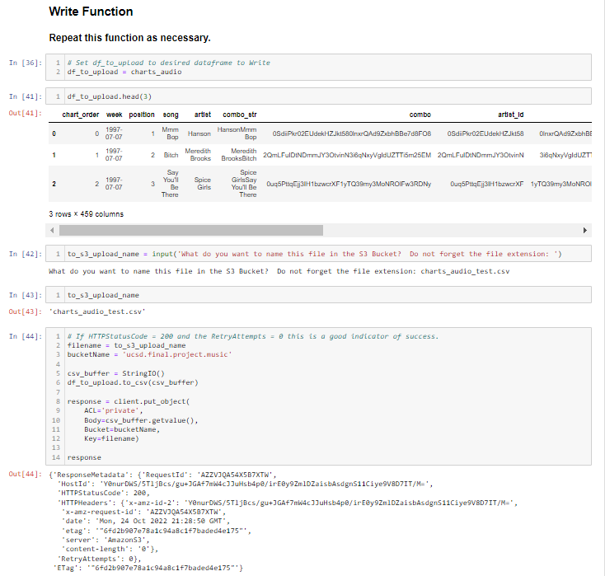
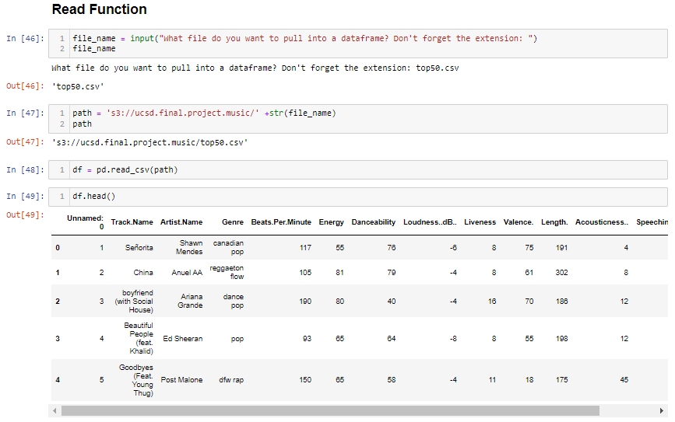
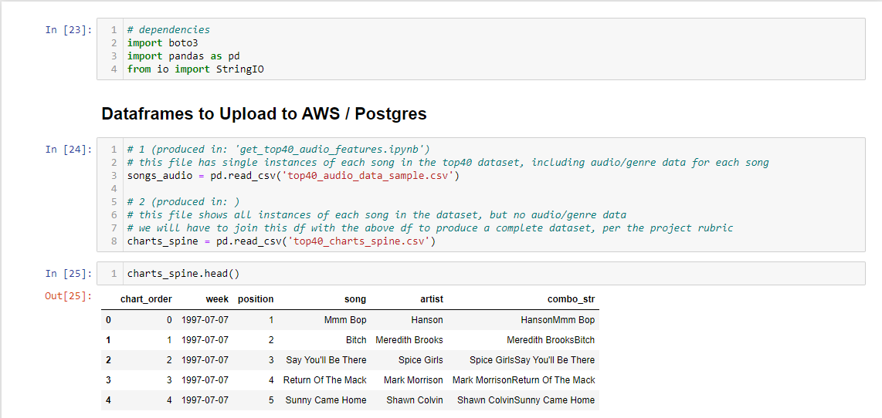
Pipeline

Slide 10
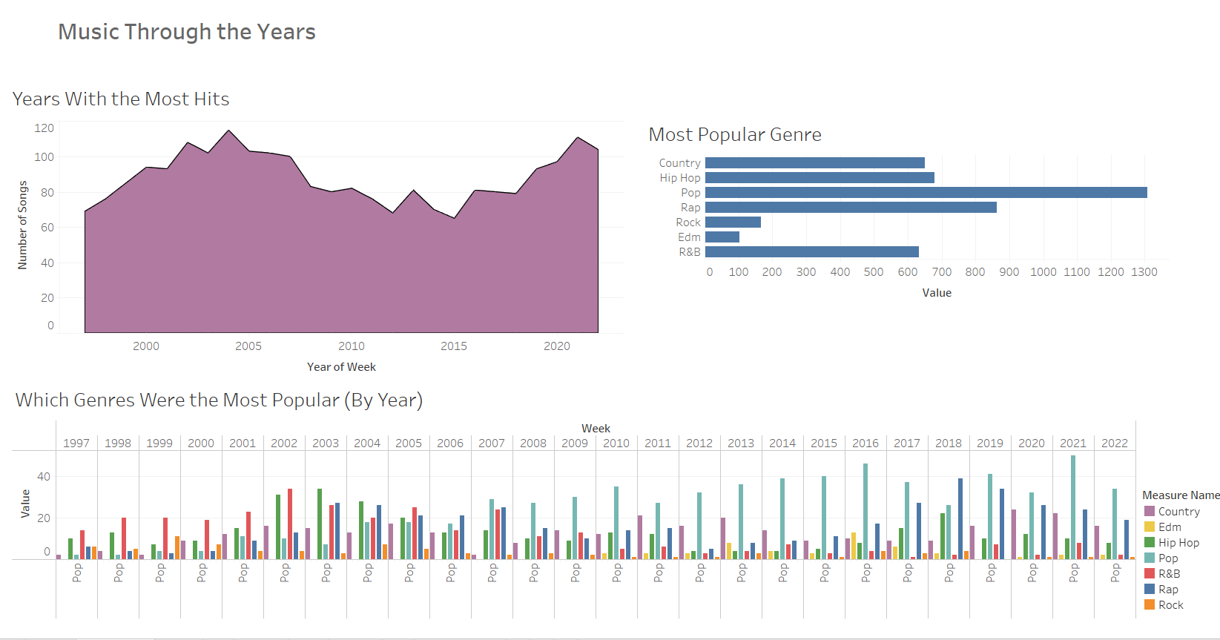
An Initial Dive into the Data:

Slide 11
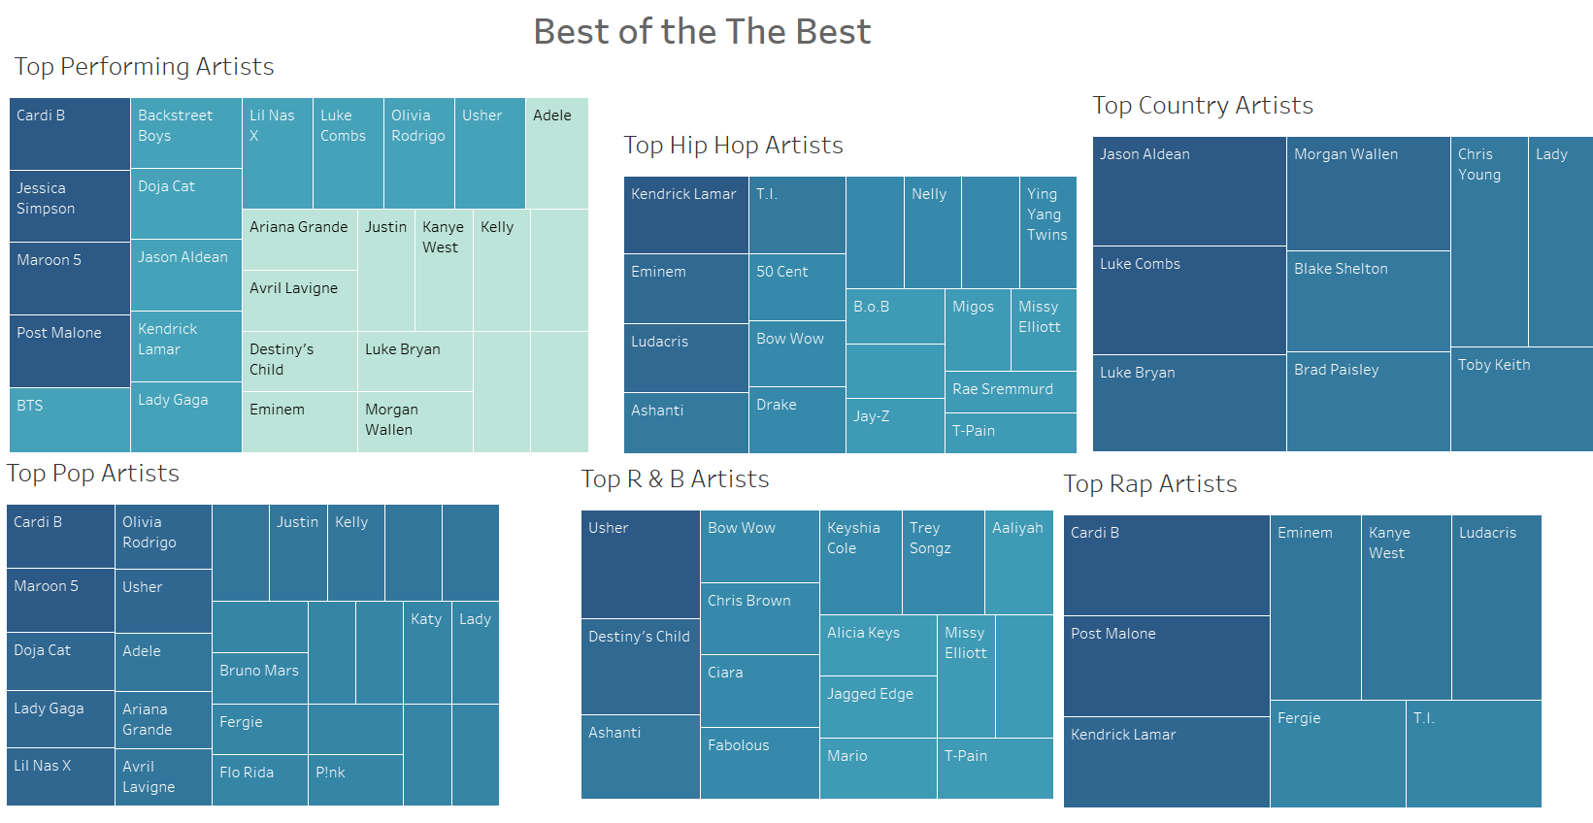
Top Artists by Genre

Slide 12

Chart Toppers!
Artists Who Dominated Their Genre
Some overlap as some artists crossed over to multiple genres
Cardi B– Songbird of Our Generation

Slide 13
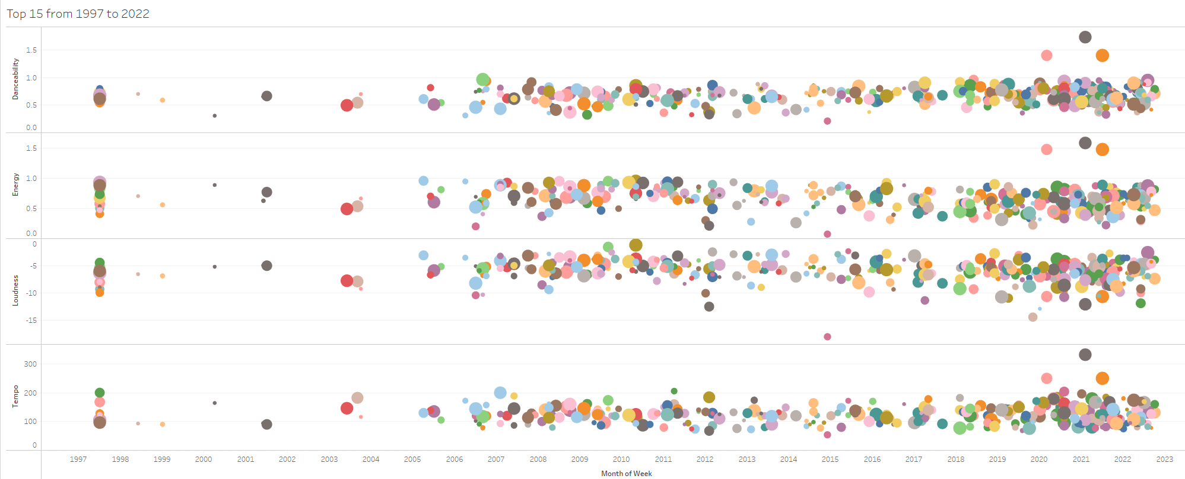
A Deeper Dive into Audio Features
Do popular songs have a commonality in audio features?
Danceability
Energy
Loudness
Tempo
Month of Week

Slide 14
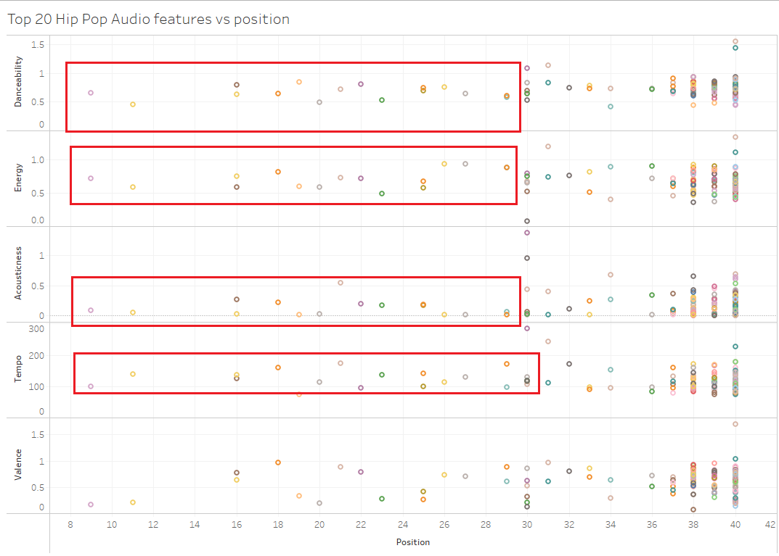
Trends within Audio Features
Danceability
Energy
Acousticness
Tempo
Valence

Slide 15
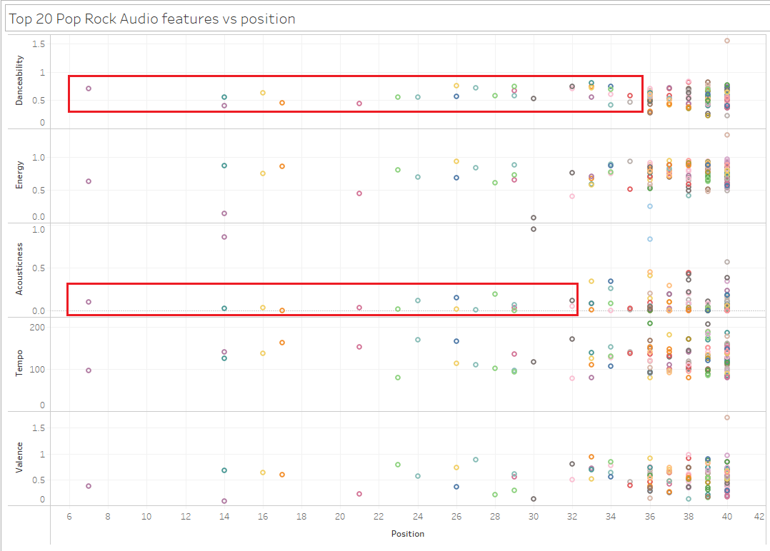
Trends within Audio Features
Danceability
Energy
Acousticness
Tempo
Valence

Slide 16
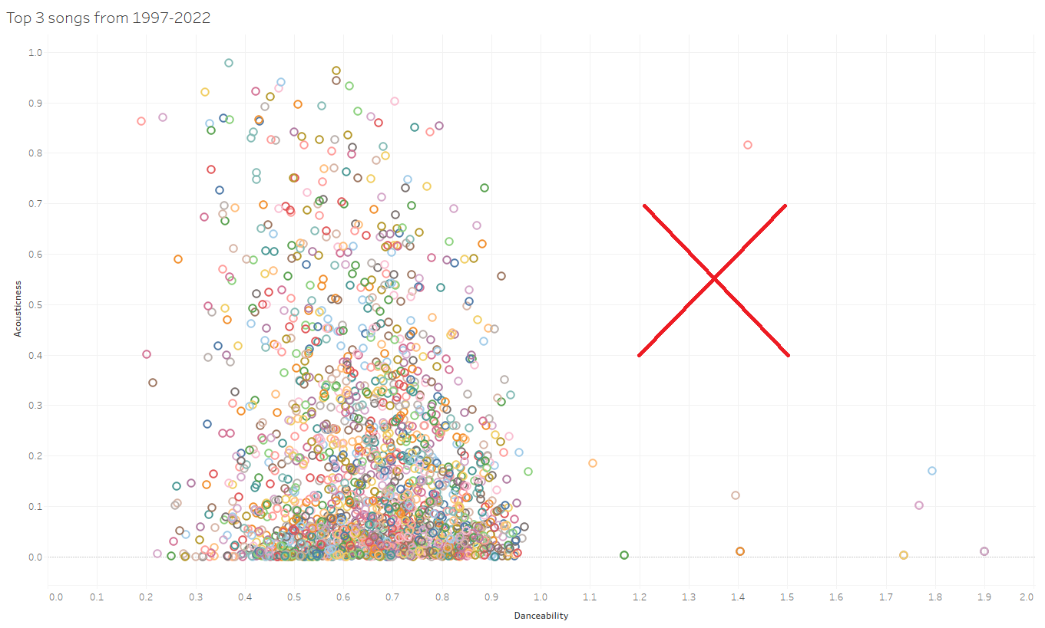
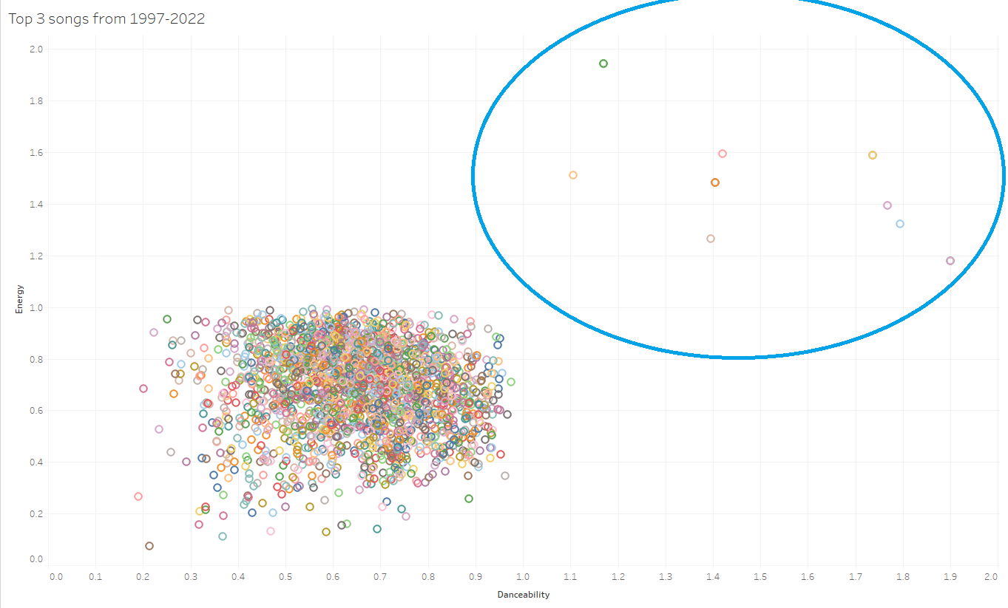
Audio Features in Top 3 Songs
Do audio features have a pattern with each other?
Danceability vs Acousticness
Danceability vs Energy

Slide 17
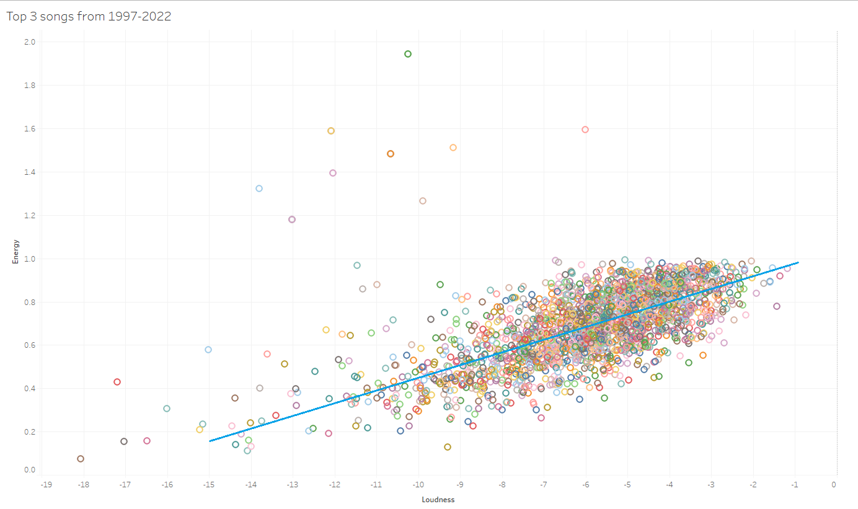
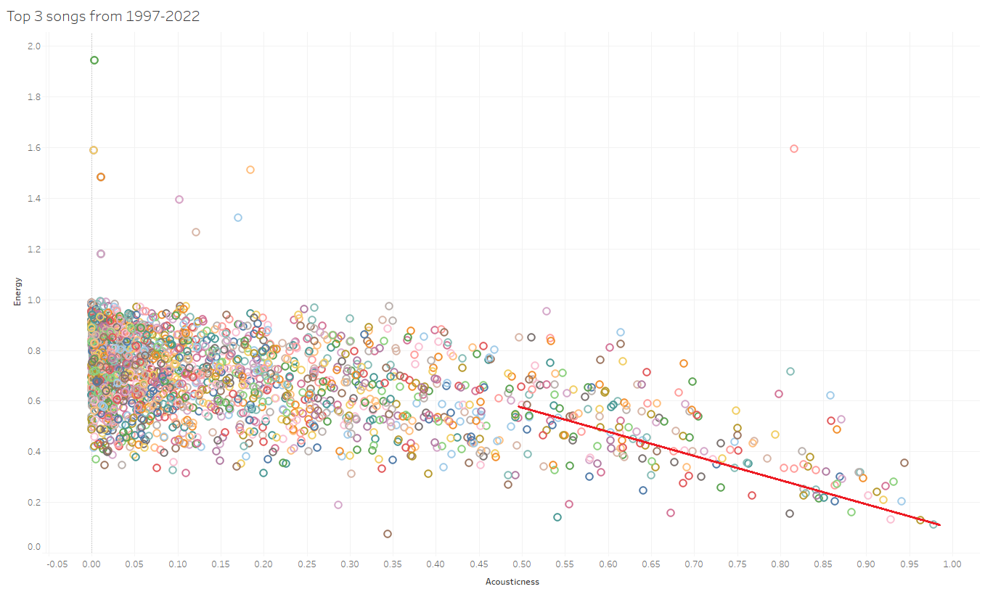
Audio Features in Top 3 Songs
Do audio features have a pattern with each other?
Energy
Energy
Loudness
Acousticness

Slide 18
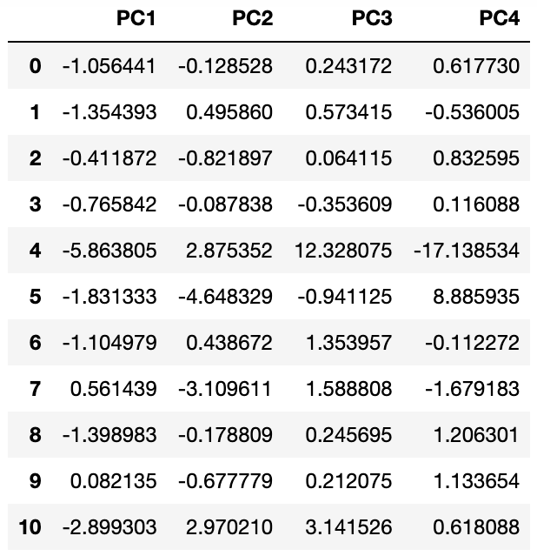
ML Model: k-means clustering
chart data
+
audio features
+
genres
Standardization
Feature selection
Feature engineering
Dimensionality reduction
k-means cluster
analysis

Slide 19
ML Model: k-means clustering
chart data
+
audio features
+
genres
Standardization
Feature selection
Feature engineering
Dimensionality reduction
k-means cluster
analysis
8 different models
Are there any identifiable patterns in the way Top 40 singles vary?
How do the audio profiles of different genres differ from one another?

Slide 20
Audio features (sometimes) define clusters, genres never do
1. Are there any identifiable patterns in the way Top 40 singles vary?

Slide 21

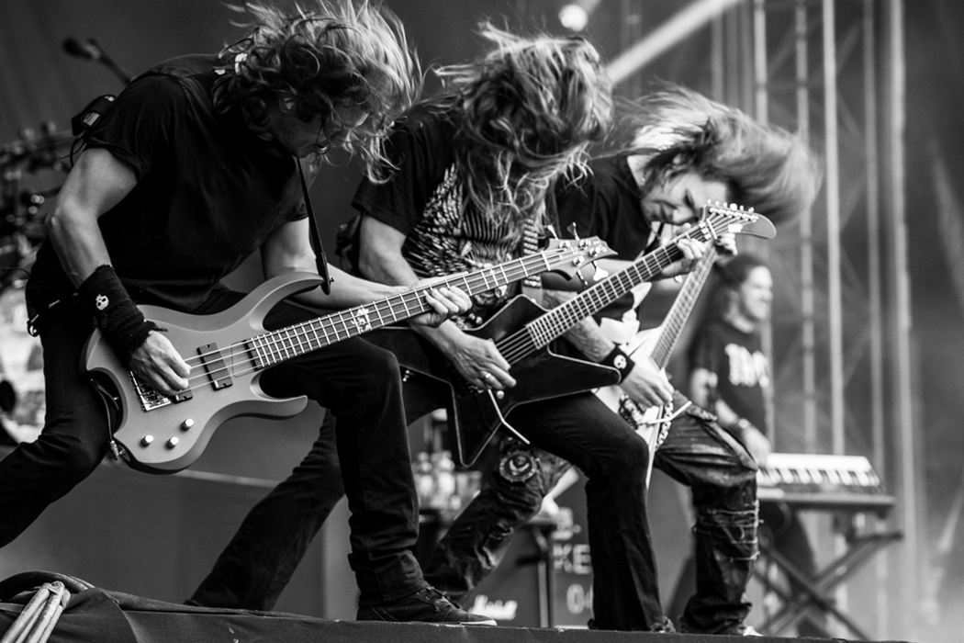
Can we actually distinguish between genres by their audio features?
2. How do the audio profiles of different genres differ from one another?
DANCE POP
METAL

Slide 22
Can we actually distinguish between genres by their audio features?
2. How do the audio profiles of different genres differ from one another?

Slide 23
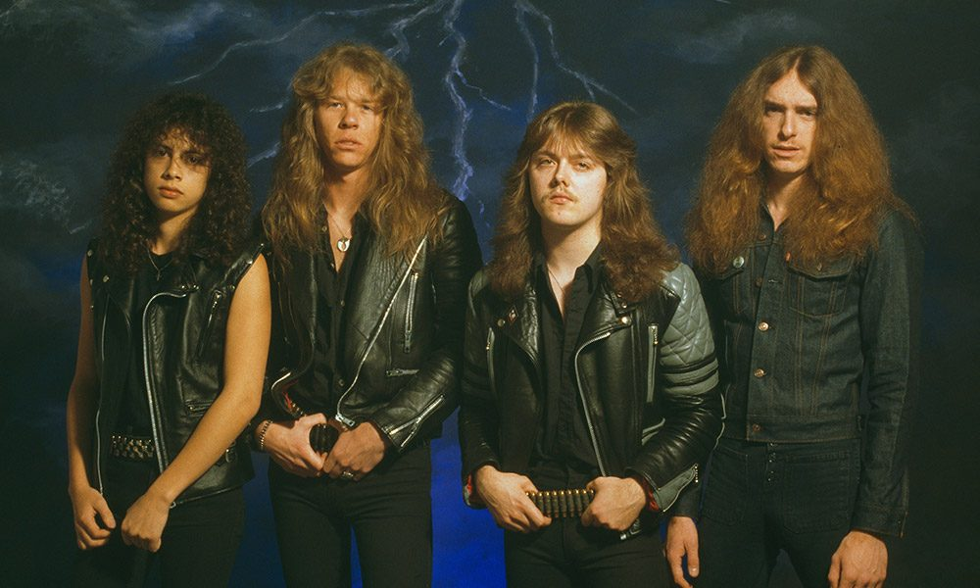
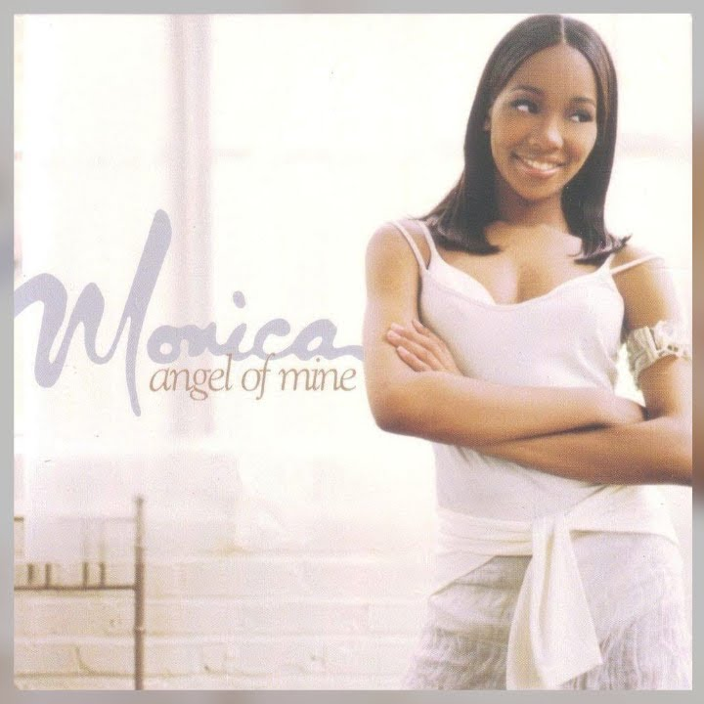

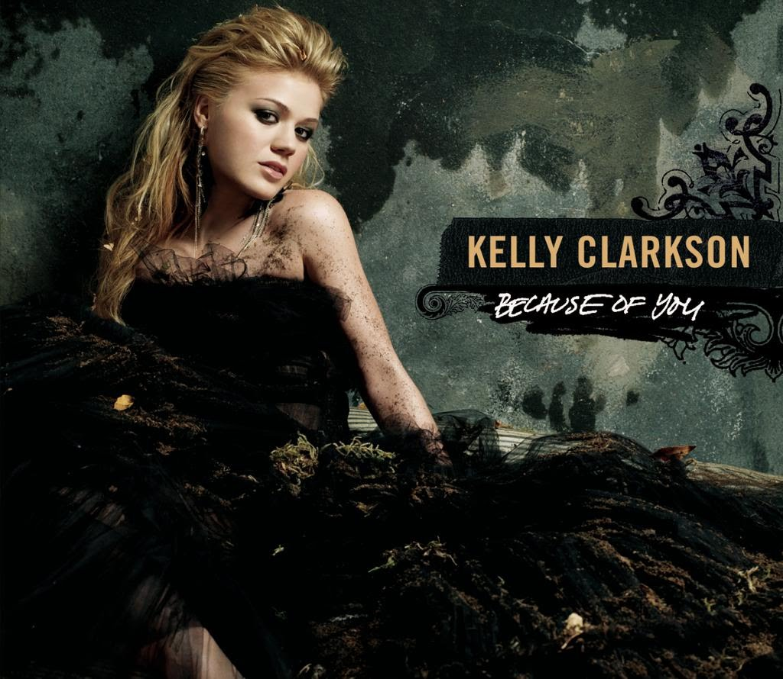
Can we actually distinguish between genres by their audio features?
2. How do the audio profiles of different genres differ from one another?
NOPE

Slide 24

Where improvements can be made
Complete the dataset!
Fine-tune data cleanup, feature selection, feature engineering
Try supervised ML to distinguish genres by audio features

Slide 25
Conclusions
The focus of this analysis was to determine:
Do popular ‘Top 40’ songs have any commonality and/or trends in audio features?
Are we able to distinguish between different genres by their audio features alone?
Exploratory analyses DO find trends in popularity over time and correlations between audio features
These trends are candidates for further study
ML models DO NOT distinguish between genres based on their audio features
These models probably need improved feature selection/engineering
Supervised ML models (e.g., random forest classifiers) may do a better job of distinguishing genres with adequate training

